Slide 1

WRITE950
Sparking imagination and nurturing
young authors

Slide 2
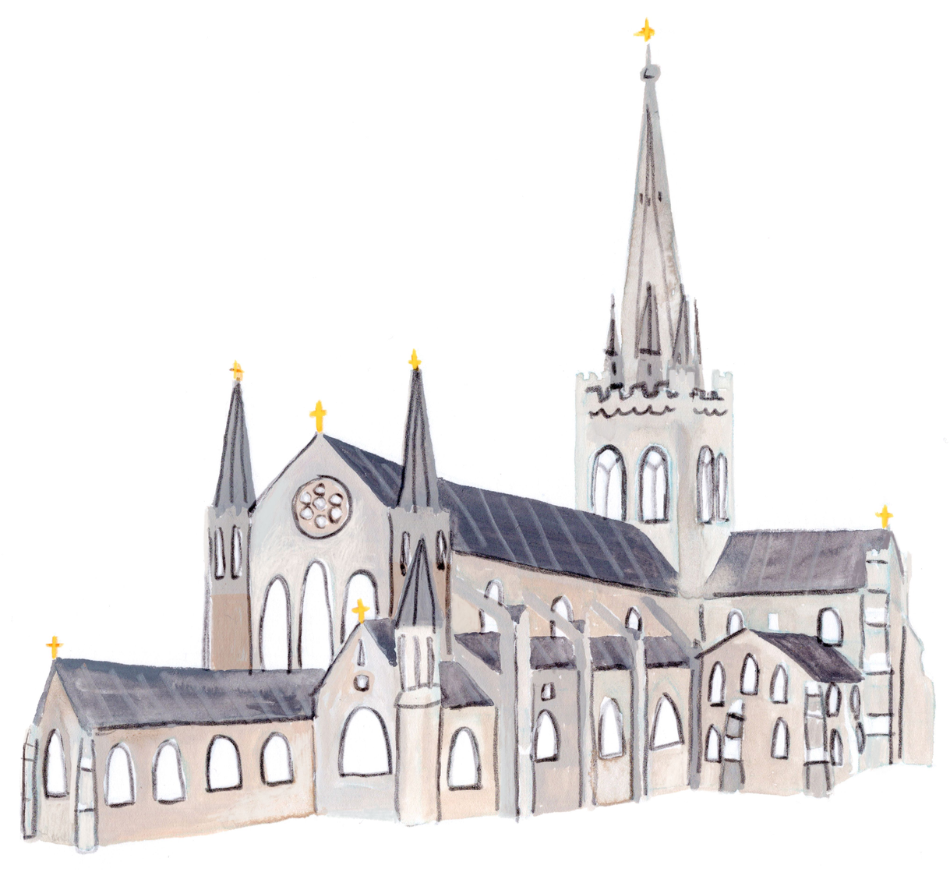
Write950: A creative writing competition for young storytellers
As part of our 950th anniversary celebrations in 2025, Chichester Cathedral is delighted to announce the launch of Write950 – a creative writing competition designed to inspire you, the children and young people of East and West Sussex to explore the Cathedral’s fascinating history, characters and sacred spaces through the power of words.

Slide 3
Watch our Write950 Video here
WRITE950 | Chichester Cathedral launches creative writing competition for children and young people

Slide 4

The competition is delivered in partnership with children’s literacy charity Children’s Bookfest, local authors Simon Philip and Ali Sparkes, and Waterstones Chichester.
Together, we aim to spark imagination and nurture storytelling skills through four entry levels:
·Amazing Authors (ages 4–7)
·Adventurous Authors (ages 8–11)
·Aspiring Authors (ages 12–15)
·Ambitious Authors (ages 16–18)

Slide 5


Entries should be no longer than 950 words – in celebration of the Cathedral’s 950th anniversary milestone. All stories must be original works of fiction, a made-up story using your imagination.
You are encouraged to take inspiration from the Cathedral’s past and present, including its rich history, characters, spiritual significance or well-known figures connected to Chichester’s story.

Slide 6

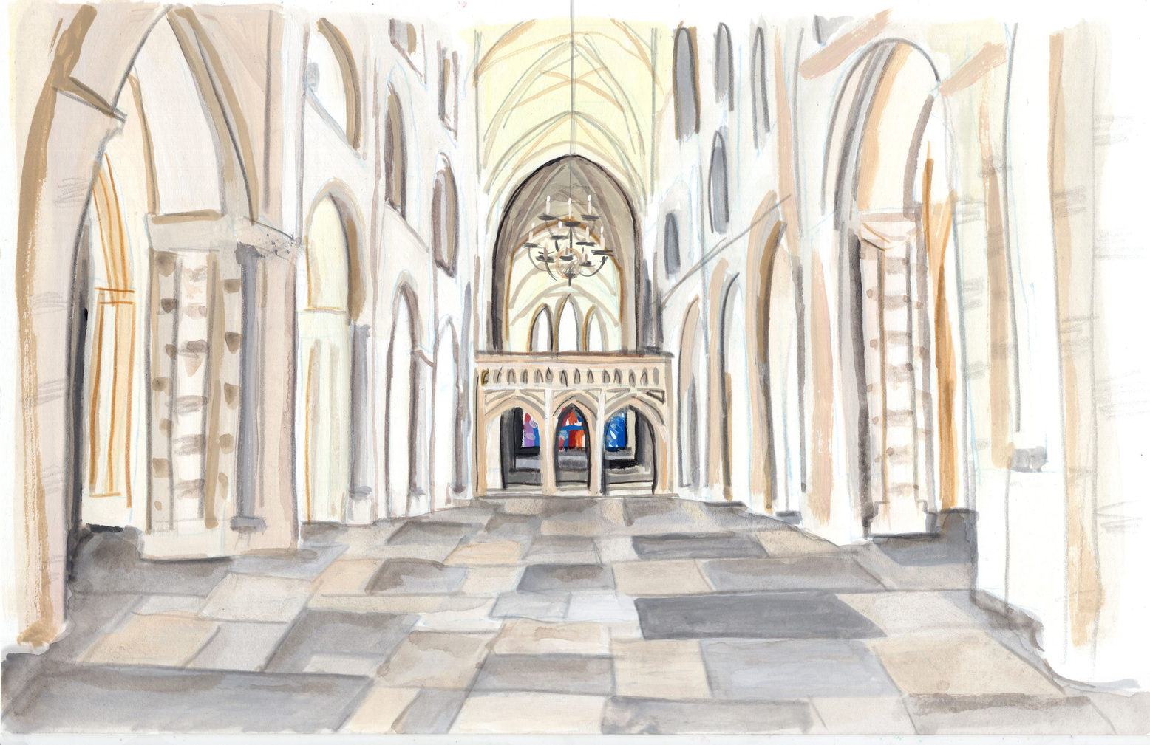
Our beautiful Cathedral Church of the Holy Trinity and mother church of the Diocese of Chichester

Slide 7
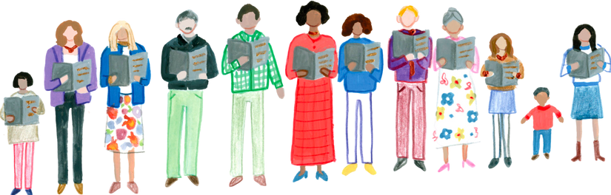
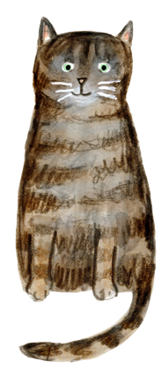
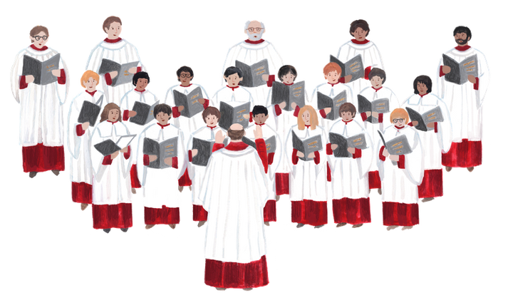
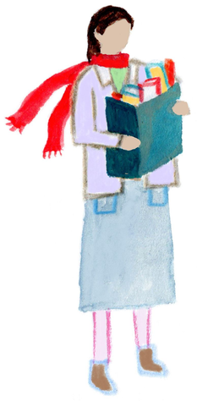
What could
you use as inspiration?
The community who worship and spend time in the cathedral
Bertie the cat who likes to go exploring around the Cathedral grounds!
People who pass the Cathedral while in town shopping
Our choir and sung heritage

Slide 8
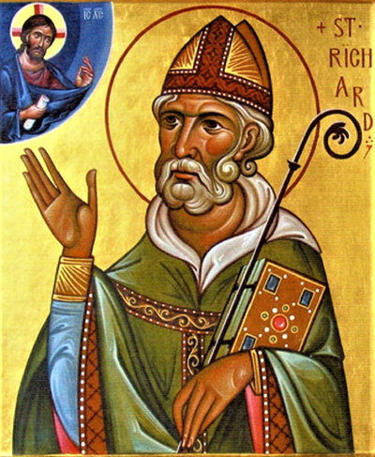
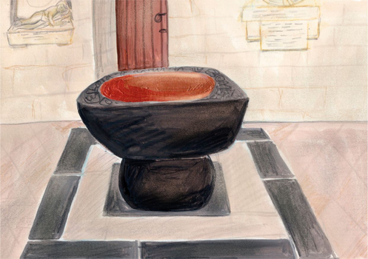

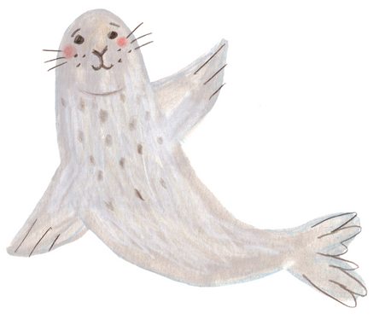
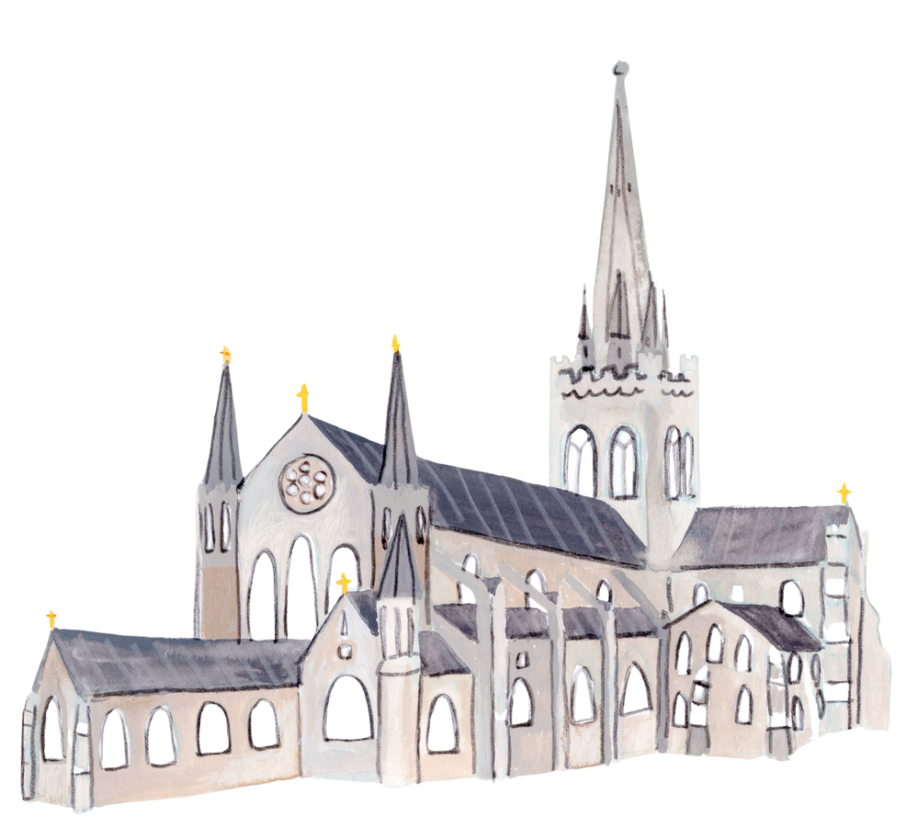
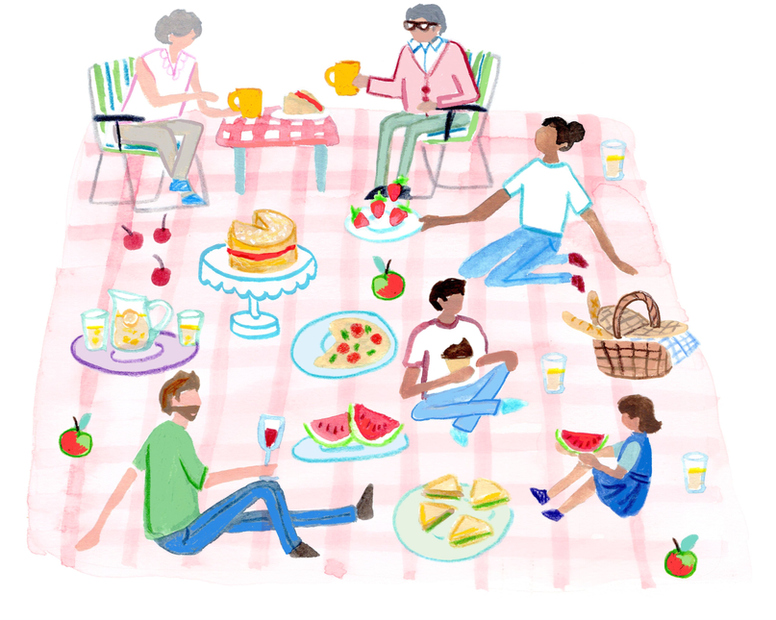
Saint Richard
Our home saint and bishop between
1244-1253
Christian faith and spirituality
The Spire
Wilfrid the seal who likes to come
inland and explore Sussex
People who come for a picnic on
the Cathedral green in the
spring and summer

Slide 9
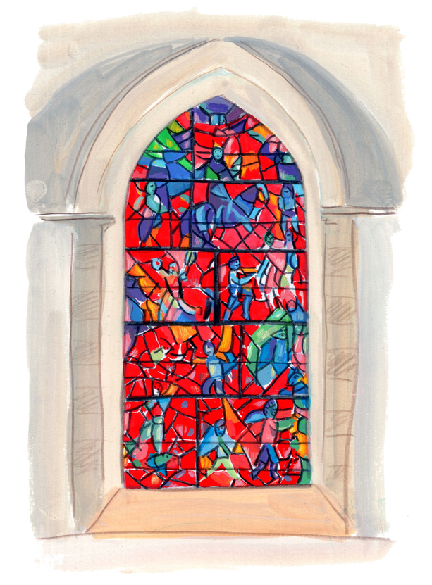
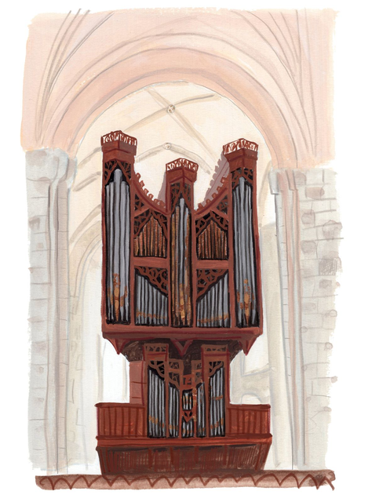
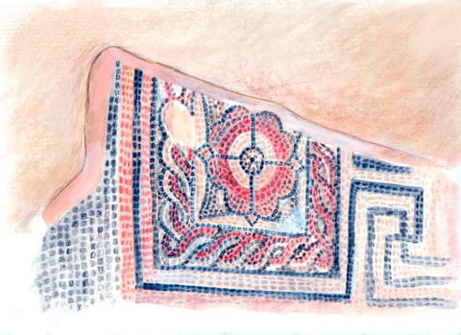
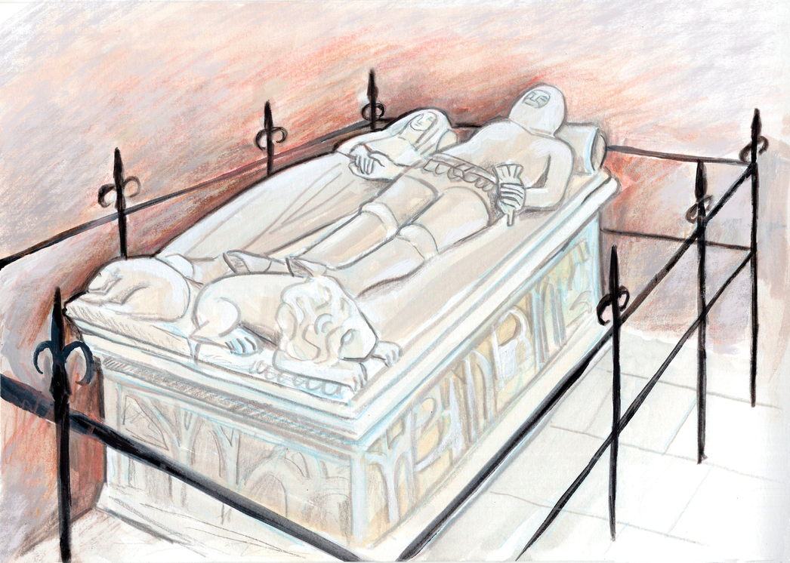
Stained glass windows
Organ music
Eleanor of Lancaster, immortalised in Larkin’s poem An Arundel Tomb
Roman mosaic discovered in 1966

Slide 10

Looking for more inspiration?
Come and visit us!
Find out how to book a school trip here Creative Learning and Discovery | Visiting with a school | Chichester Cathedral

Slide 11

Top Tips from Simon Philip for our Amazing Authors (ages 4–7)
WRITE950 | Tip 1 | Amazing Authors (4 -7)

Slide 12

Top Tips from Simon Philip for our Adventurous Authors (ages 8–11)
WRITE950 | Tip 2 | Adventurous Authors (8-11)

Slide 13

Top Tips from Ali Sparkes for our
Aspiring Authors (ages 12–15)
and
Ambitious Authors (ages 16–18)
WRITE950 | Tip 3 | Aspiring Authors (12-15) & Ambitious Authors (16-18)

Slide 14
Winners will be chosen by a judging panel made up of Simon Philip, Ali Sparkes, Katy Roberts from Waterstones Chichester, and Rosie Bradberry from the Cathedral.
Waterstones Chichester is also generously providing a wonderful prize for each category – the opportunity to choose a brand-new book in the Waterstones Chichester store each month for a whole year!
All winners will be celebrated at a special event held at Chichester Cathedral in September 2025.

Slide 15




Terms and Conditions
You must live in either West or East Sussex to enter Write950
You must be the correct age for your category by the competition deadline – Sunday 20 July 2025.
Your entry must be submitted by an adult, this could be your parent, carer, teacher or community group leader.
All entries must be emailed to write950@chichestercathedral.org.uk.
Entries can either be typed or scanned copies of handwritten work.
Please include your full name, age, category you are entering, name of the city, town or village in which you live, school you attend or home educating network you are part of at the top of your entry.

