Slide 1

CHICHESTER
2026
Lay Chapter Members
Recruitment Pack
CHICHESTERCATHEDRAL.ORG.UK
1

Slide 2
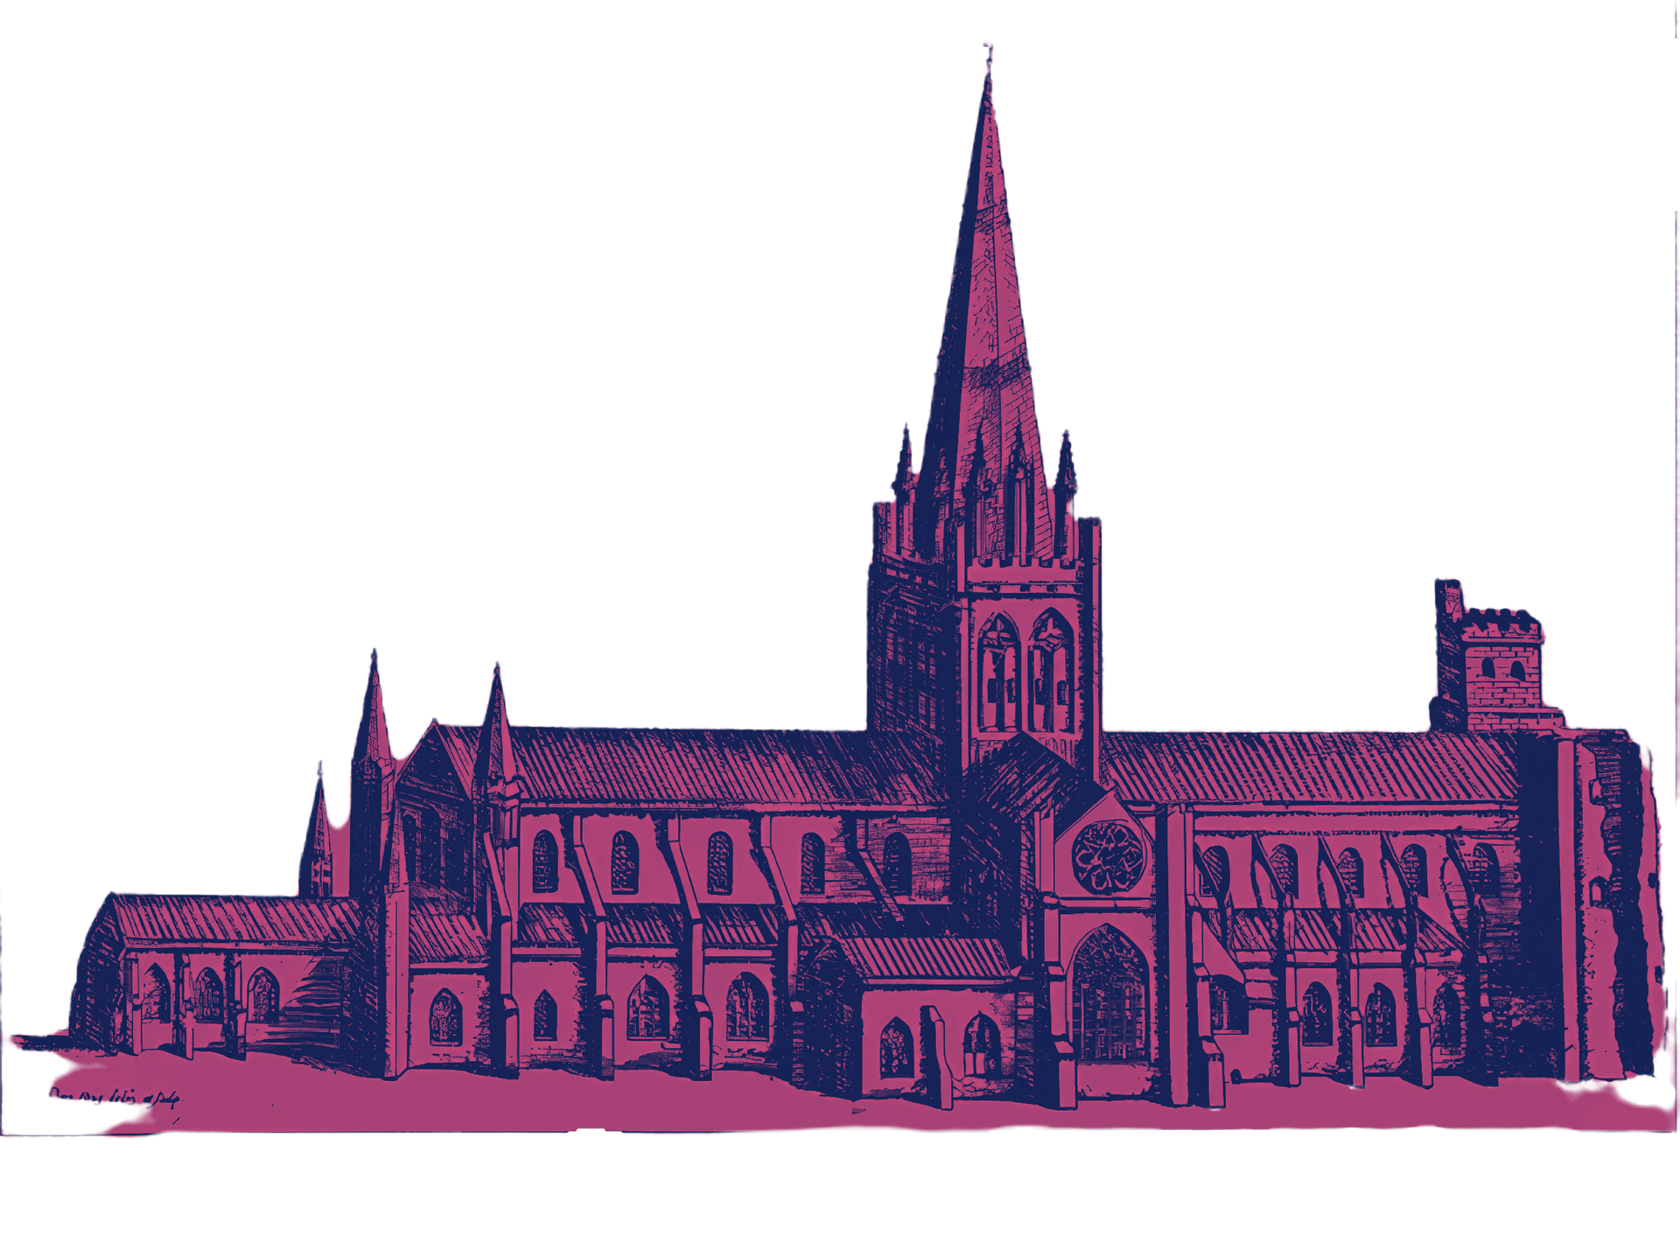
About us
2026
The Cathedral is a living, working place of worship that has stood at the heart of Chichester for more than nine centuries.
Through inspiring worship, excellent music, long-standing commitment to the visual arts, thoughtful teaching and generous hospitalit
it seeks to be a place of transformation, where people encounter the unconditional love and compassion of God.
As the Mother Church of the Diocese of Chichester, serving East and West Sussex, the Cathedral is also a much-loved visitor destination, a venue for music and the arts, and a vibrant hub at the centre of community life, welcoming around 250,000 visitors each year. Its ministry and mission are sustained by a committed worshipping congregation, alongside a dedicated team of staff and volunteers.
The Cathedral building itself, a Grade I listed landmark, brings together Norman and Gothic architecture in a striking blend of the ancient and the modern. Within its walls is a remarkable collection of 20th-century paintings, tapestry, sculpture and glass, adding further richness to its spiritual and cultural life.
The Cathedral receives no statutory or Church of England funding and is entirely self-supporting, relying on the generosity of donors, fundraising efforts and the income it generates through its work.
CHICHESTERCATHEDRAL.ORG.UK
2

Slide 3
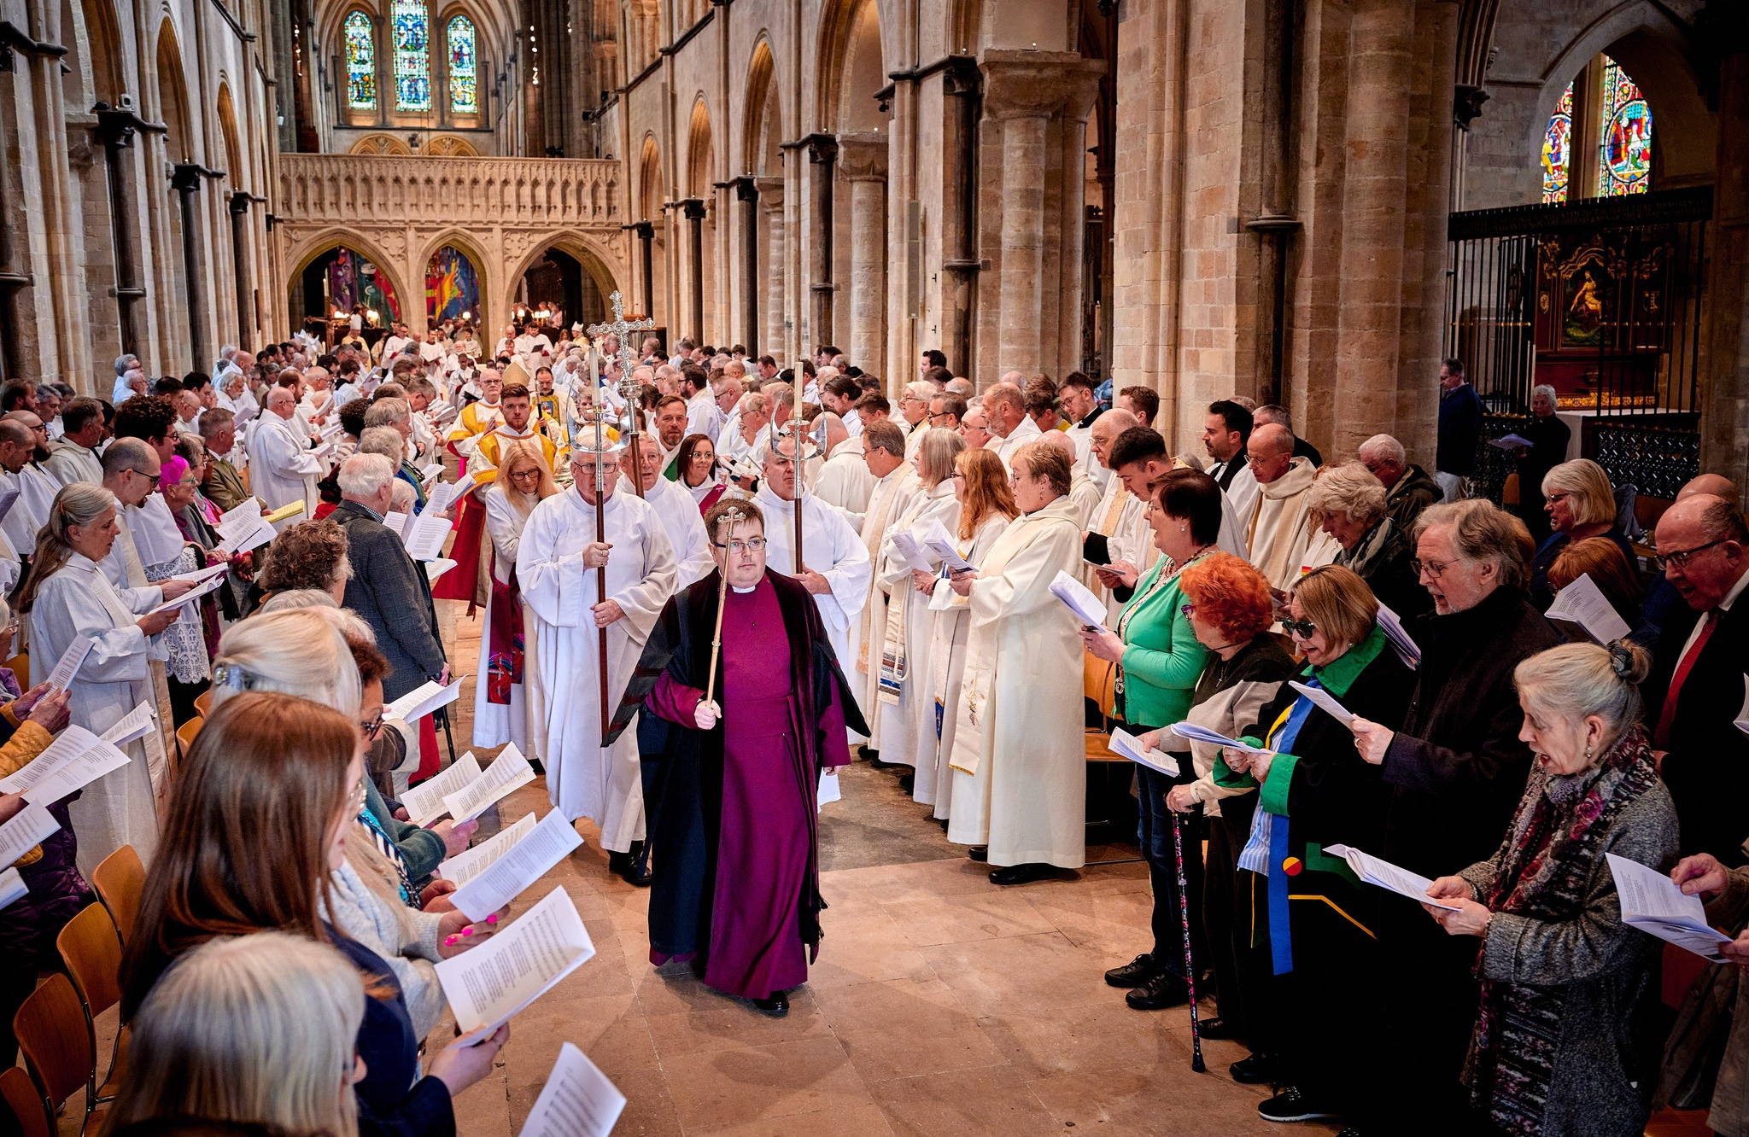
About the vacancies
2026
Chichester Cathedral’s Chapter currently meets on the Cathedral estate approximately six or seven times each year, with occasional meetings held off site. Chapter members may choose to be involved in the worshipping life of the Cathedral through regular and special services, although this is not expected to be at the expense of existing commitments to their local church. This is a voluntary, non-executive position and it is unpaid, although reasonable expenses can be reimbursed.
The term ‘Chapter’ originates from the gathering of monks or canons to hear the reading of a chapter of the Bible or a section of their rule of life. Today, Chapter serves a different purpose, though one that continues to be held within a framework of prayer and Christian commitment: it is the body responsible for the Cathedral’s strategy and governance. It includes both clergy and lay members, who work together to support the effective and faithful running of the Cathedral.
In charity terms, the Cathedral is a registered charity and lay Chapter members function as charity trustees. It is an important role that calls for sound judgement and some business acumen, although aptitude and attitude matter more than formal qualifications.
CHICHESTERCATHEDRAL.ORG.UK
3

Slide 4
Your responsibilities
2026
As a lay Chapter member, you would work collaboratively with other Chapter Members and colleagues to:
  promote the Cathedral’s role as a centre of worship and mission, serving the diocese and wider community;
  provide strategic oversight and establish clear governance to enable the Cathedral to achieve its vision and purpose through appropriate activities and use of resources;
  ensure that robust systems are in place for risk management, internal controls, safeguarding, health and safety, and regulatory compliance;
  help assess potential risks to the Cathedral and ensure that they are appropriately mitigated;
  promote the Cathedral’s Anglican identity and values;
  monitor the Cathedral’s performance (financial, operational and mission) against agreed plans, budgets and key indicators;
  ensure financial stability, overseeing the integrity of financial information and ensuring that financial controls and management are appropriate and robust;
  act as ambassadors for the Cathedral, protecting and enhancing its reputation, public benefit and charitable purpose.
On this occasion, we are particularly seeking Chapter members who may be able to act as leads in the areas of:
  Safeguarding: working with lay, executive and clerical colleagues, including the Cathedral’s Safeguarding Officer, to provide strategic oversight of safeguarding by ensuring it is embedded within governance, leadership, culture and decision-making.
  Commercial: working with lay, executive and clerical colleagues to develop opportunities for income generation through the Cathedral’s commercial operations while balancing this with its unique role as a place of worship and centre for Christian mission, and to provide oversight of commercial activity to ensure it is appropriately integrated into strategic planning and aligned with the Cathedral’s mission.
  GDPR: working with lay, executive and clerical colleagues, as appropriate, to ensure that the Cathedral has robust processes for managing data and meeting its legal obligations as a data controller.
Full role descriptors for each role are available on our website at:
chichestercathedral.org.uk/jobs
CHICHESTERCATHEDRAL.ORG.UK
4

Slide 5
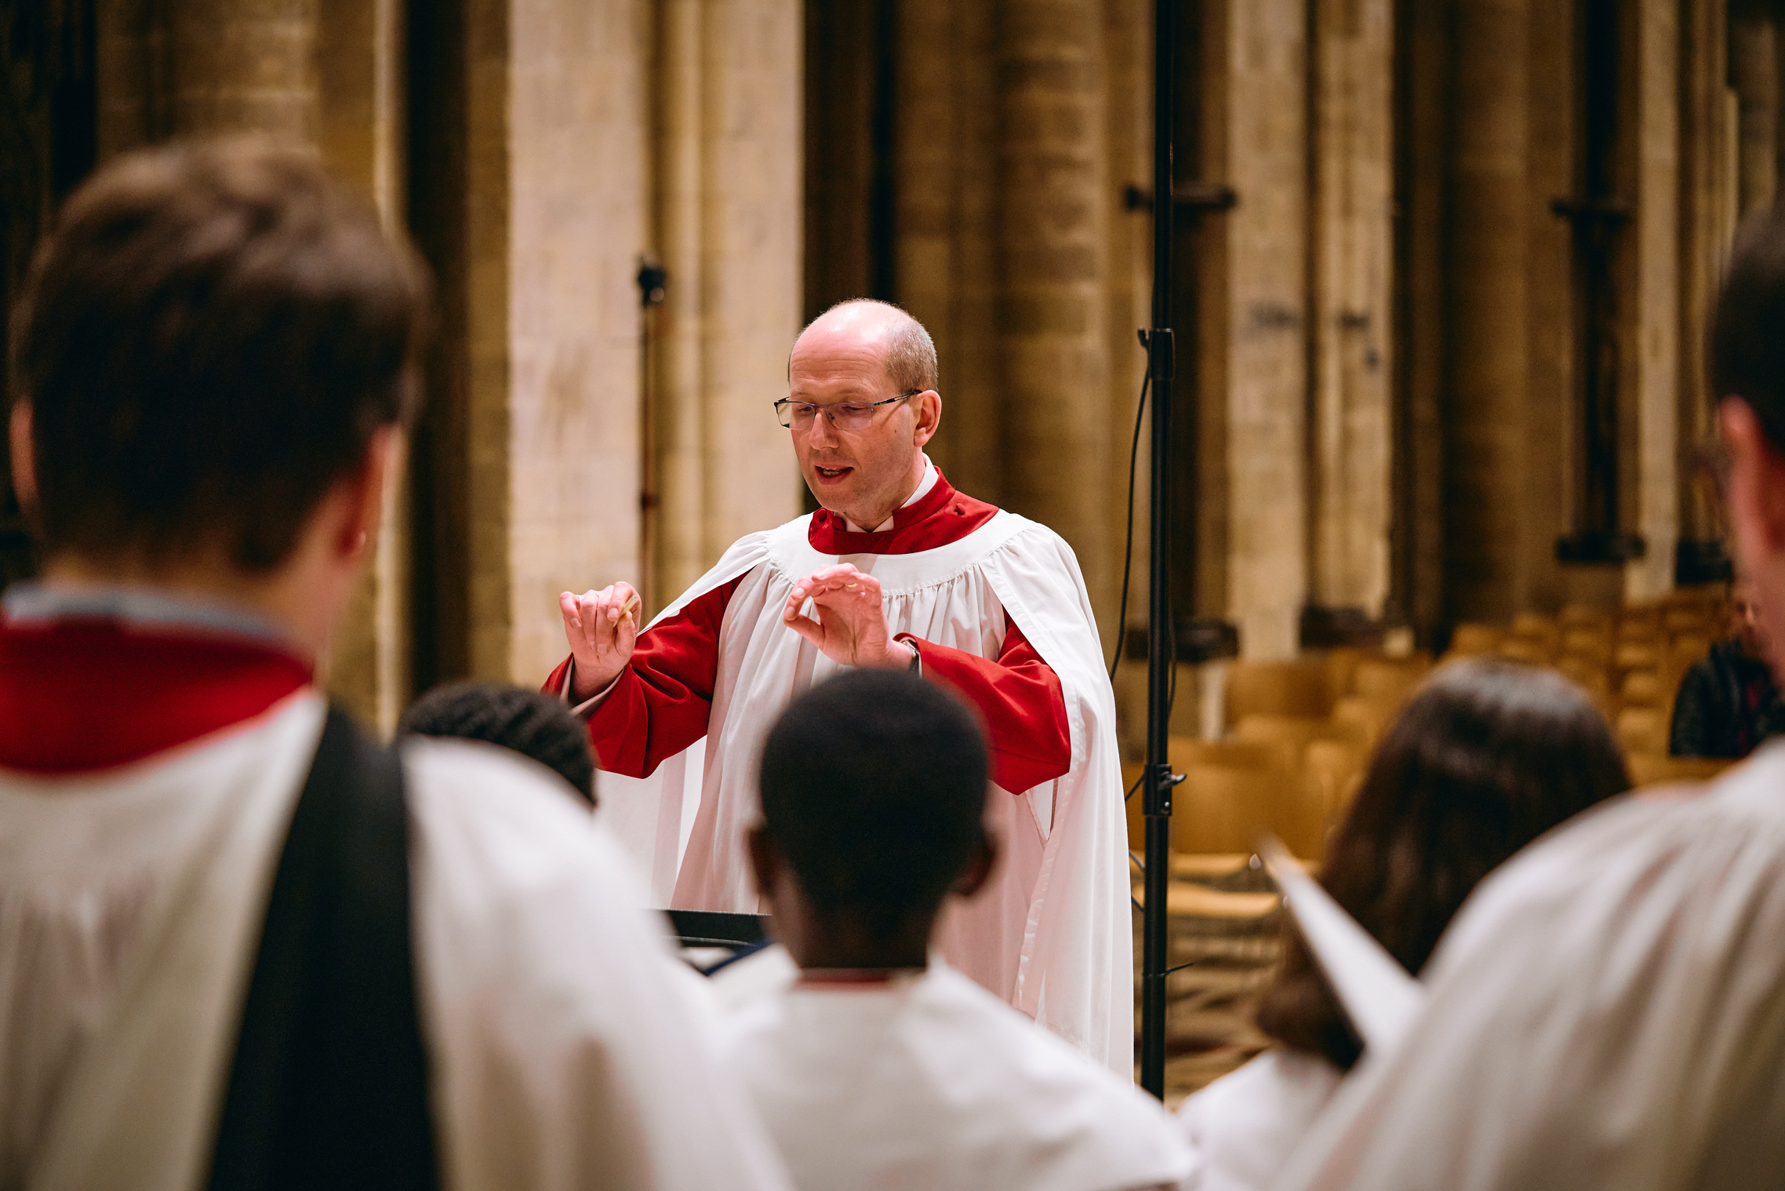
About you
2026
We are looking for someone who:
  is a communicant member of the Church of England;
  has the aptitude to understand the complex life and work of a Cathedral and contribute to the development of our strategic plans;
  is an excellent communicator, able to listen well, articulate their views clearly and support effective decision-making;
  has the ability to understand, summarise and analyse reports, data and other information in order to support effective decision-making;
  takes a collaborative, team-focused approach and is able to engage constructively with a wide range of people;
  is confident in offering constructive challenge and sharing their views where appropriate.
In addition, our leads will also have specific areas of knowledge, skills and experience:
  Safeguarding Lead: significant experience, understanding or professional exposure to safeguarding, risk management, compliance or regulatory frameworks and familiarity with the Church of England safeguarding framework or the aptitude to develop knowledge in this area quickly;
  Commercial Operations Lead: commercial operations experience ideally obtained within a similar environment and ideally experience of working with volunteers;
  GDPR Lead: a good understanding of relevant data protection laws and their application within a charity setting.
  If you meet our person specification and are excited by this role, we would be very pleased to hear from you.
CHICHESTERCATHEDRAL.ORG.UK
5

Slide 6
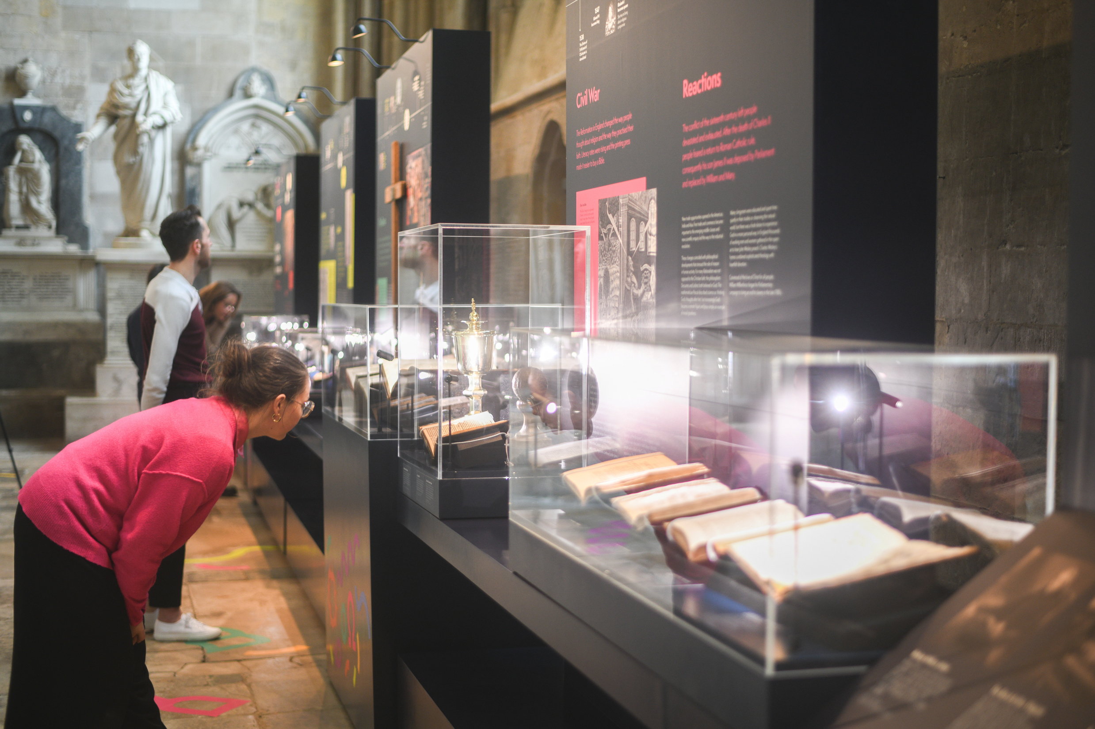
Safeguarding
2026
In accordance with Church of England’s policy, Promoting a Safer Church and the House of Bishops’ Safeguarding Policy and Practice Guidance, Chichester Cathedral is committed to the safeguarding of children, young people, and vulnerable adults who may be at risk.
The Cathedral works in partnership with the Diocese of Chichester to ensure that we operate in accordance with best practice at all times.
The care and protection of children, young people and vulnerable adults are the responsibility of the whole Cathedral community, whether clergy, staff, volunteers, contractors, or members of the congregations. Everyone who participates in the life of the Cathedral has a role to play in promoting a safe environment for all.
To learn more about Safeguarding at the Cathedral please see our website.
Equality & Diversity
At Chichester Cathedral we are committed to encouraging a supportive and inclusive workplace culture amongst our employee and volunteer workforce. It is our aim to ensure that if you work here or apply to work here, on either a paid or voluntary basis you will have an equal opportunity. We are also committed to working towards an organisation workforce that is diverse and as representative of our wider community as it can be.
We respect and value each of our employees and volunteers and are committed to enabling you to be able to perform to the best of your abilities and to be your authentic self in the workplace.
CHICHESTERCATHEDRAL.ORG.UK
6

Slide 7
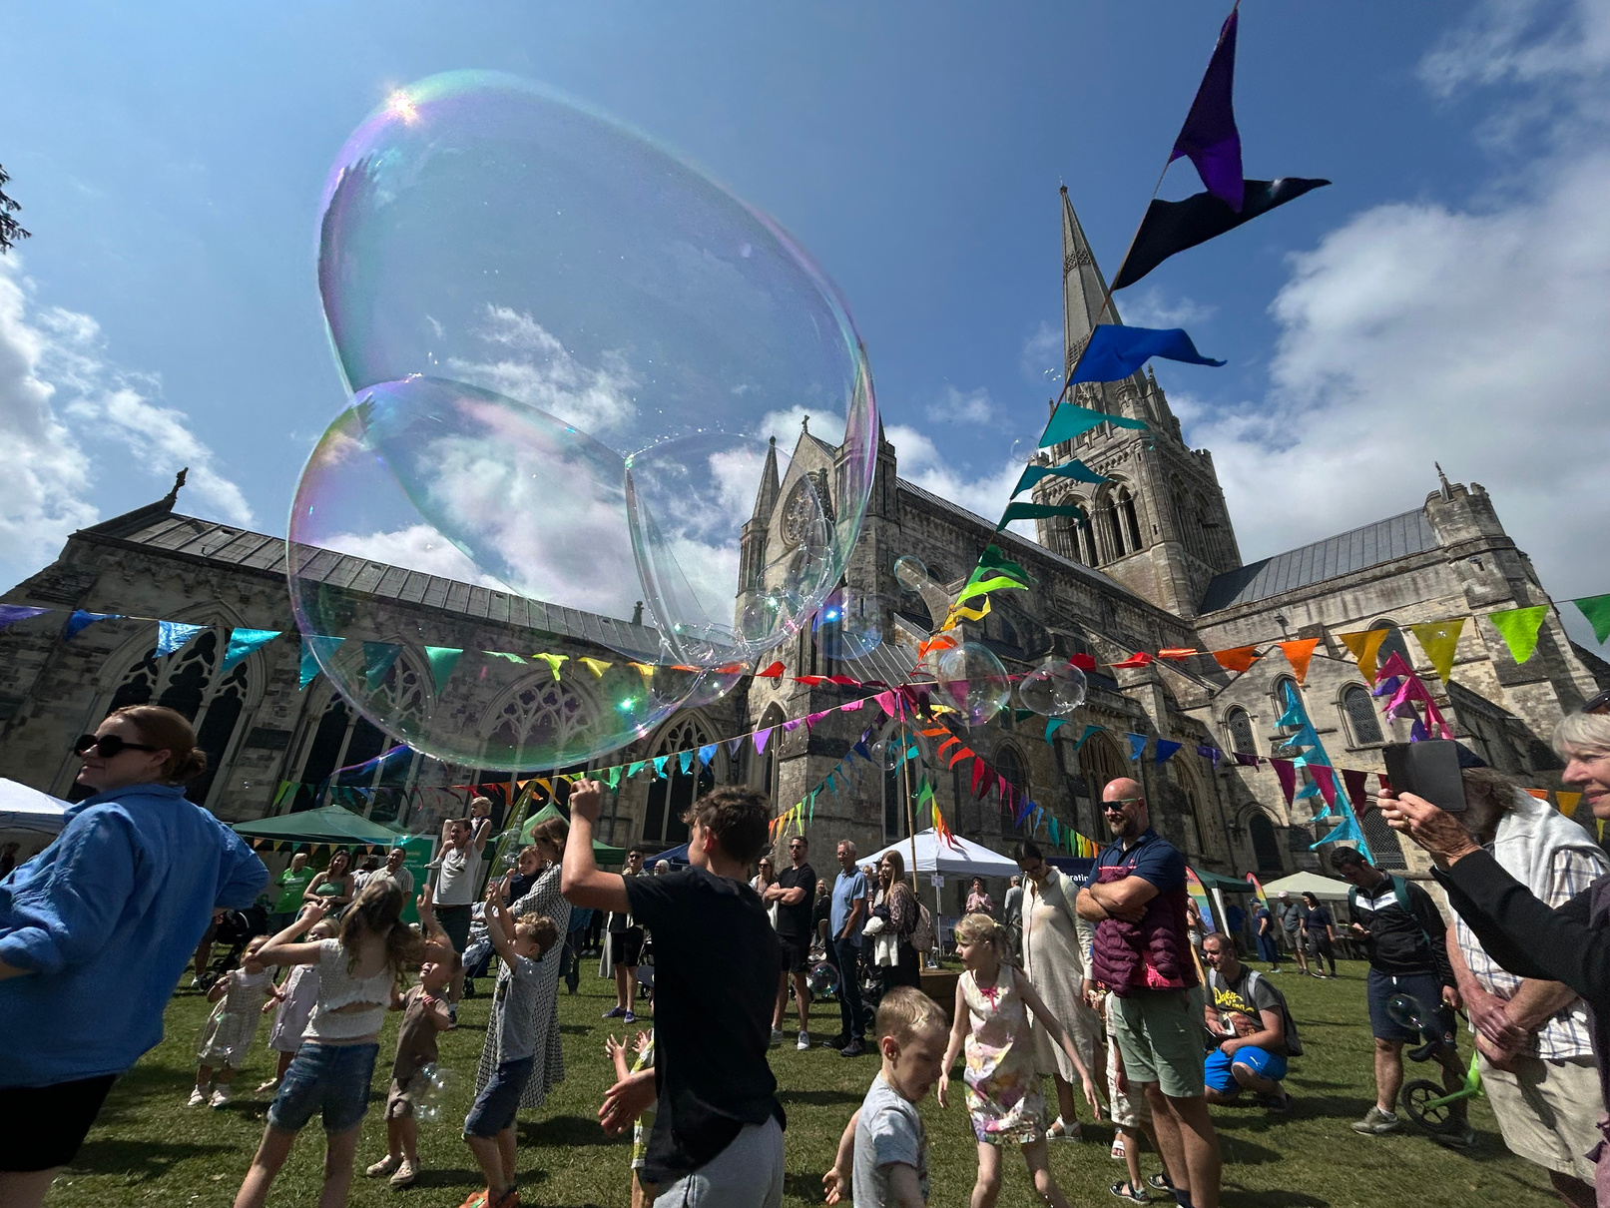
How to apply
2026
Please send your CV including your supporting statement outlining how your experience makes you a suitable candidate for our role and why you would like to work for Chichester Cathedral
to: hr@chichestercathedral.org.uk
Please note that if you are selected or interview, you will be required to complete an amended application form in line with the Church of England’s safer recruitment practice.
Key dates:
  The closing date for applications is 9.00am on 17/08/2026
  Interviews will take place in person in Chichester on 02/09/2026
If you wish to discuss this role, please email: louise.smith@chichestercathedral.org.uk to arrange a convenient time for discussion with a current Chapter member.
CHICHESTERCATHEDRAL.ORG.UK
7

